Slide 1
Finding Rules for Comparing Fractions
7.8 Miss Hager

Slide 2
Mental Math and Fluency
Count fractions starting at 0 clapping at the wholes.
Count by halves to 4 ($\frac{8}{2}$)
Count by fourths to 3 ($\frac{12}{4}$)
Count by eighths to 2 ($\frac{16}{8}$)

Slide 3
Daily Challenge Bellringer:

Slide 4
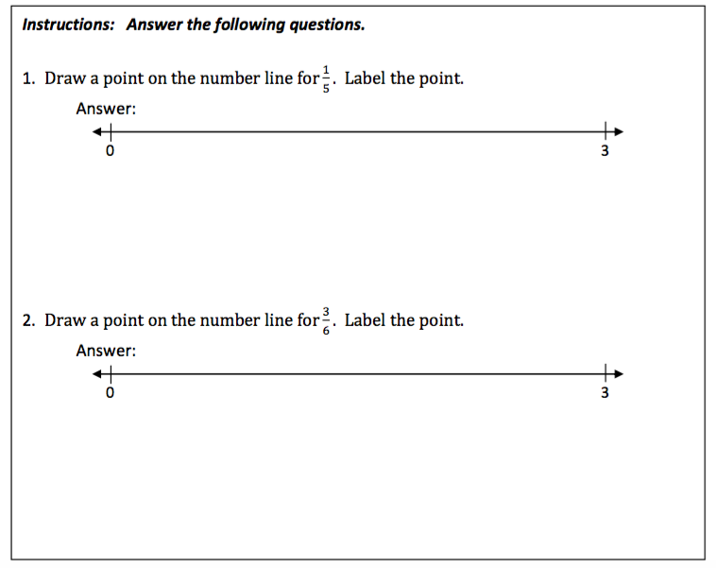
Daily Challenge Bellringer:

Slide 5
Math Message
Follow-Up:
Journal
Page 238

Slide 7
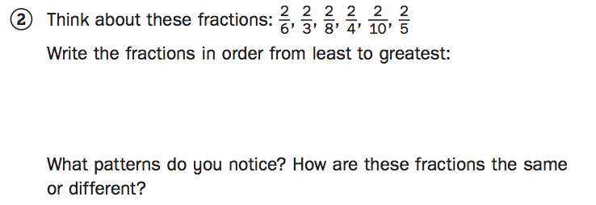
Part 2

Slide 8
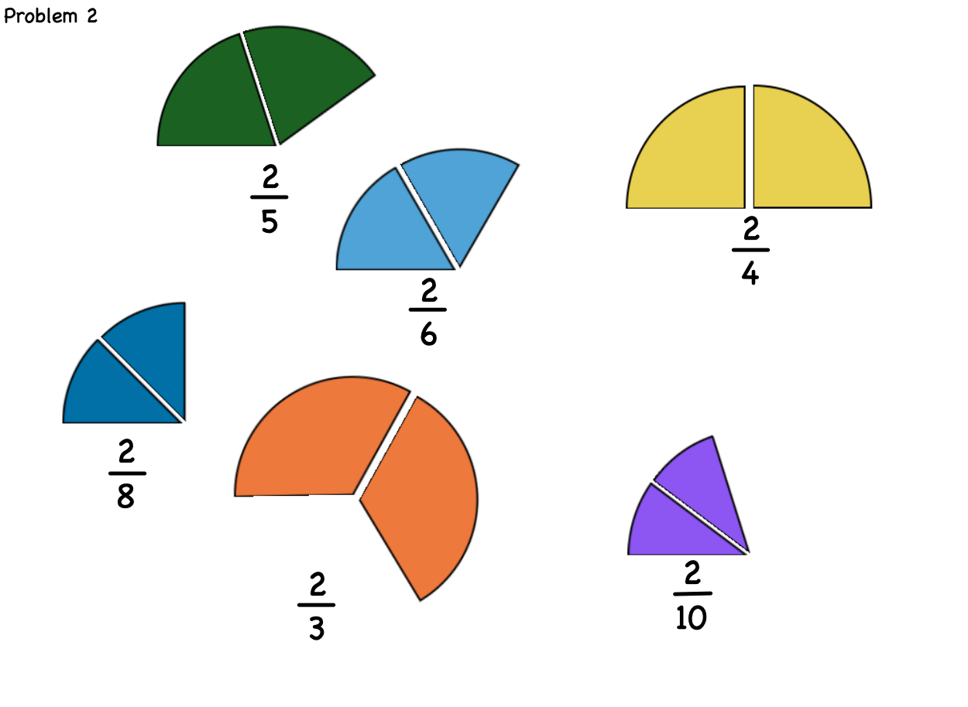

Slide 10
Bigger denominators make smaller fractions when the numerators are all the same
Words to consider for your rule: order numerator denominator greater greatest smaller least

Slide 12
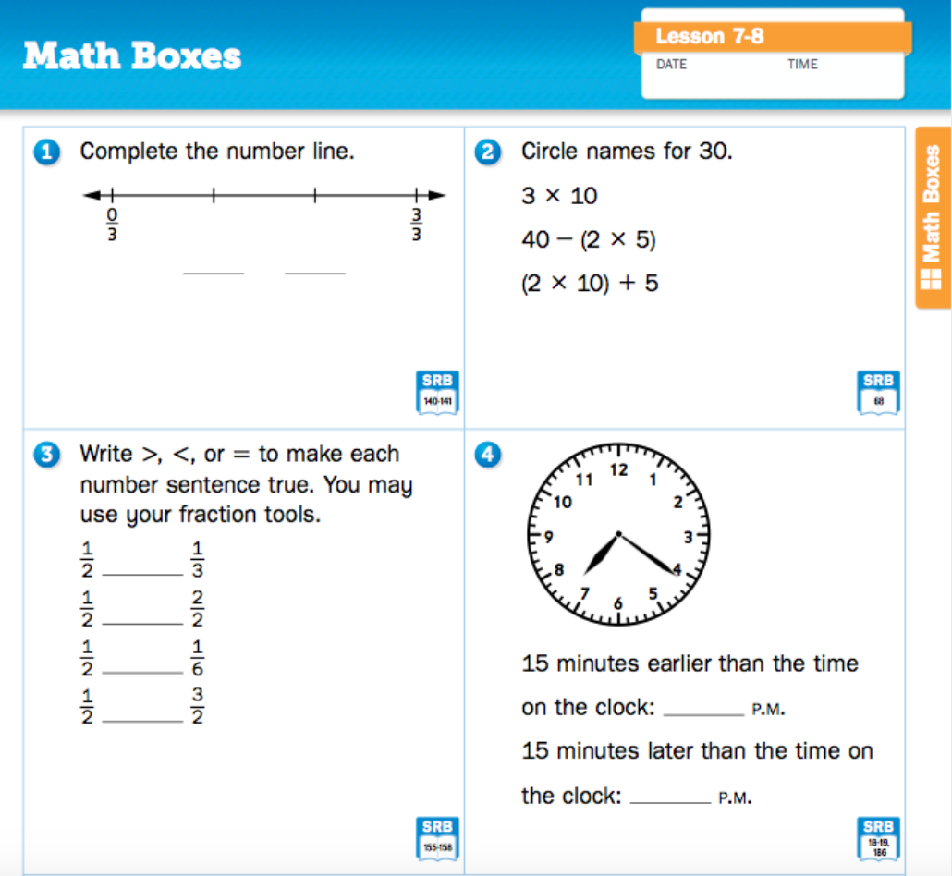
Math Boxes
Journal
Page 239

Slide 13
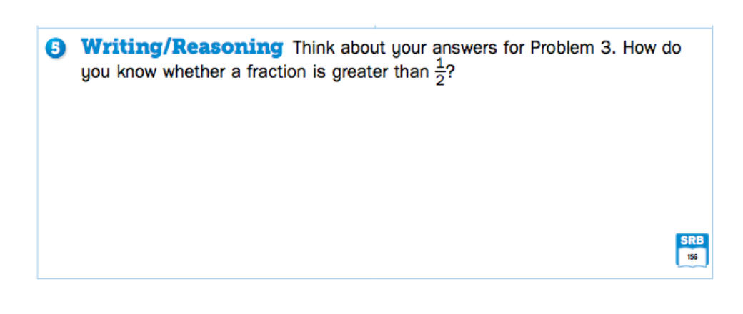
Math Boxes
Journal
Page 239

Slide 14
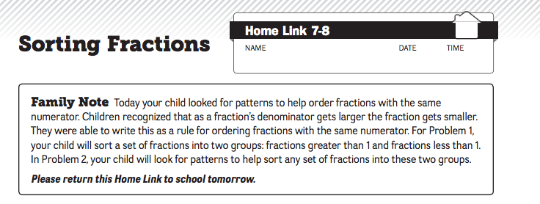
Home Link:

Slide 15
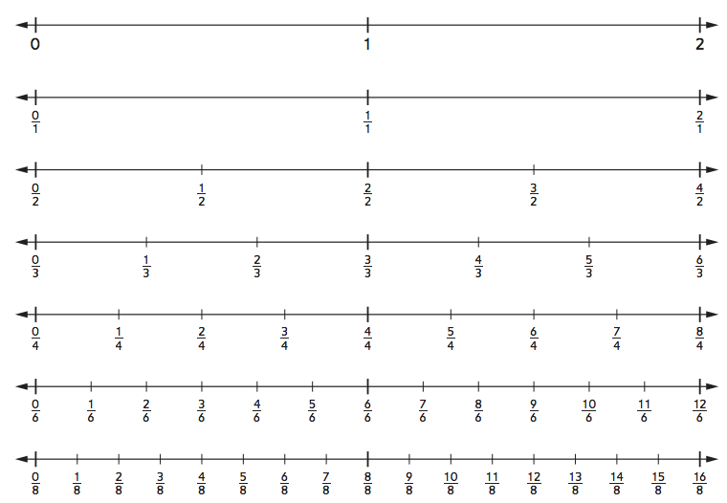

Slide 16
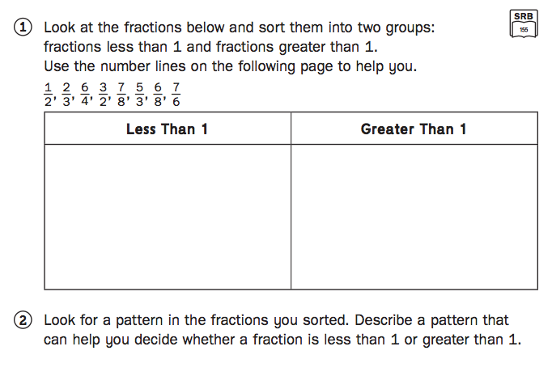
Home Link:

