Slide 1
8.4
Setting Up Chairs
Miss Hager

Slide 2
Record at least one factor pair for each number.
12

Slide 3
Record at least one factor pair for each number.
16

Slide 4
Record at least one factor pair for each number.
27

Slide 5
Record at least one factor pair for each number.
40

Slide 6
Record at least one factor pair for each number.
80

Slide 7
Record at least one factor pair for each number.
180

Slide 8
Essential Question:
How do you use clues to make conjectures and arguments to show if the statement is accurate?

Slide 9
Vocabulary
Conjecture: A statement that is thought to be true based on some information or mathematical thinking.

Slide 10
Vocabulary
Argument: Mathematical reasoning that shows whether a conjecture is true or false. You can use words, pictures, and symbols when you make a mathematical argument.

Slide 11
Essential Question:
How do you use clues to make conjectures and arguments to show if the statement is accurate?

Slide 12
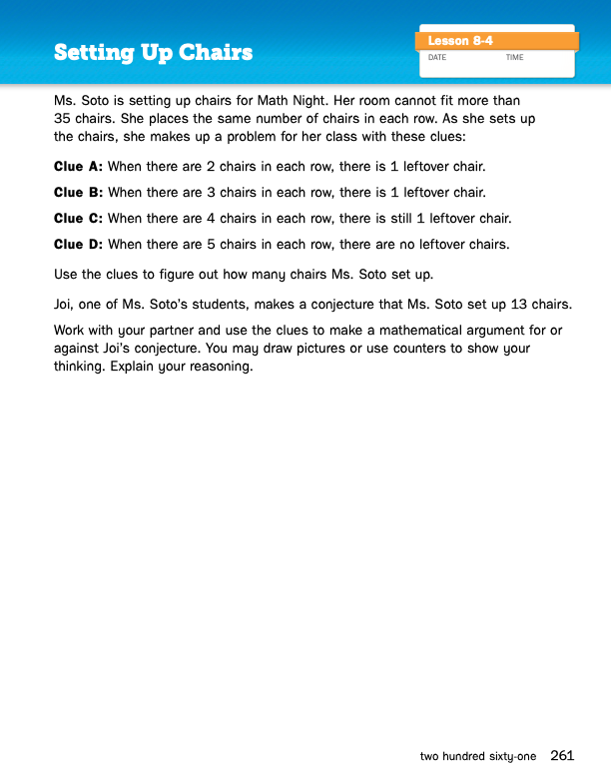
Journal
Page 261

Slide 14
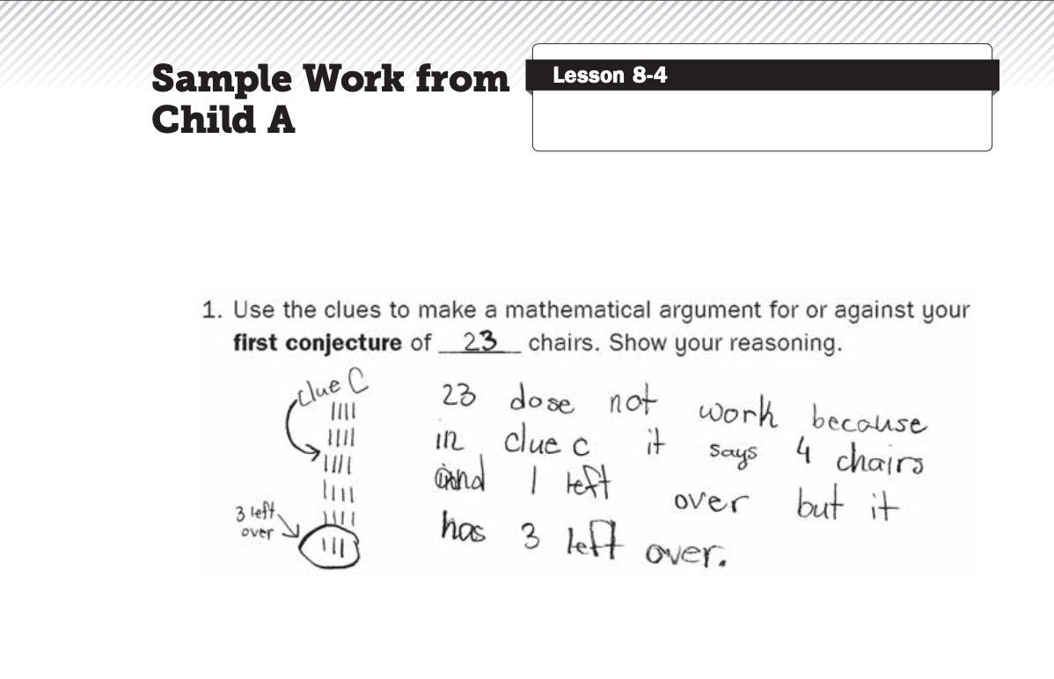

Slide 15
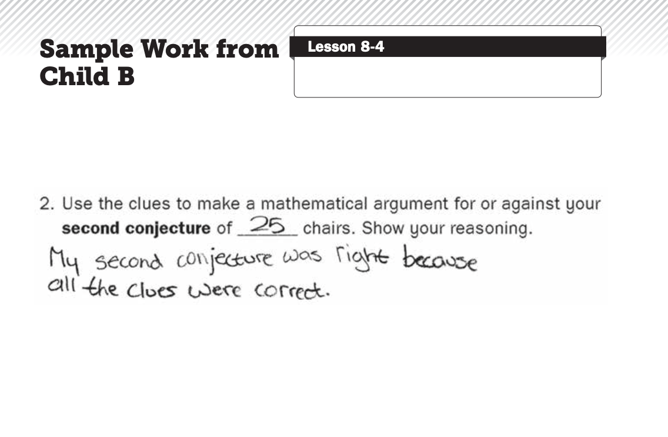

Slide 16
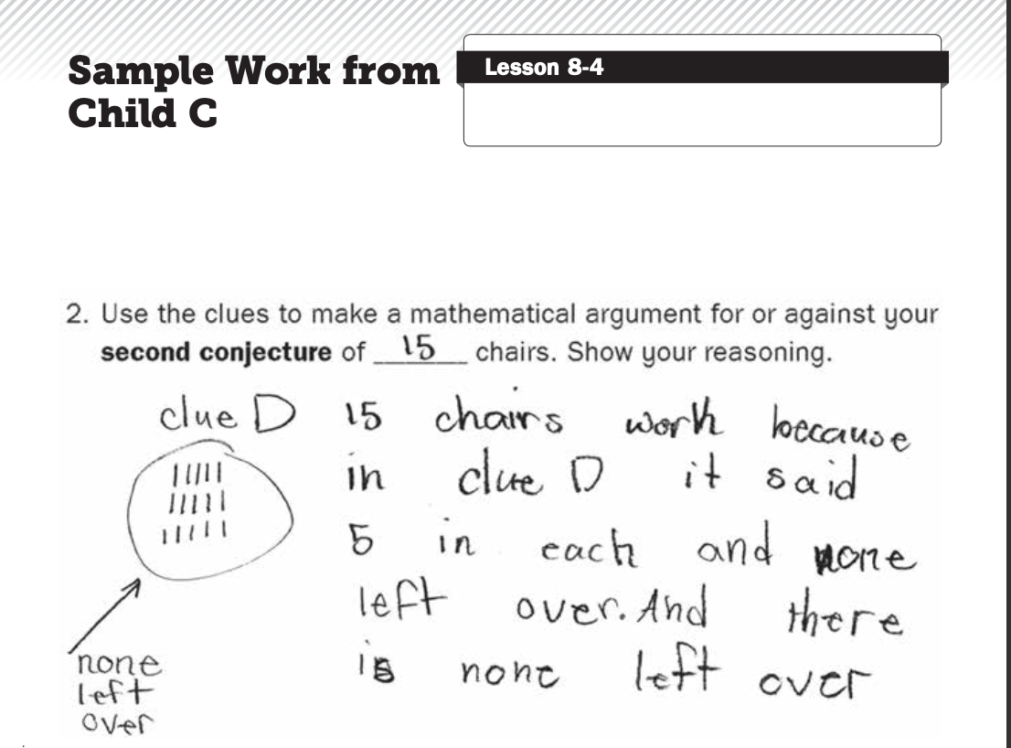

Slide 17
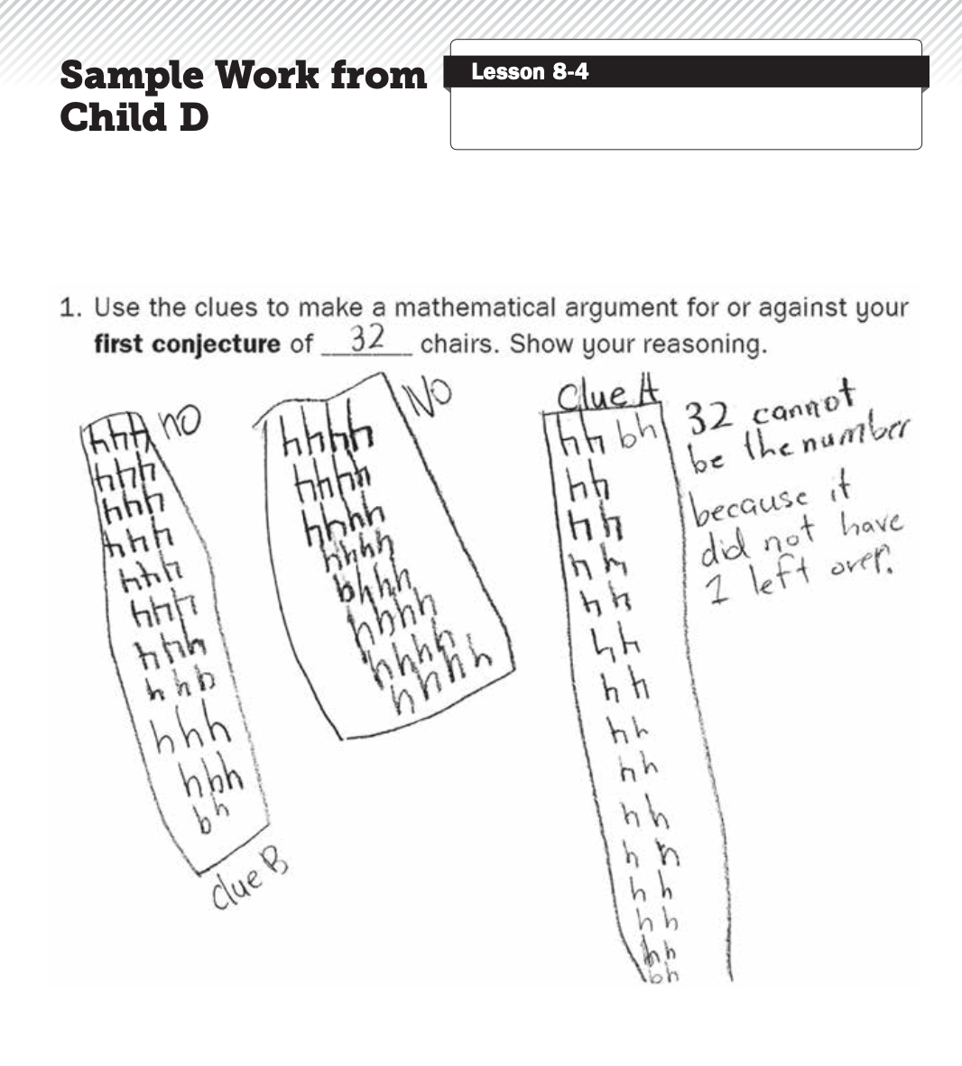

Slide 18
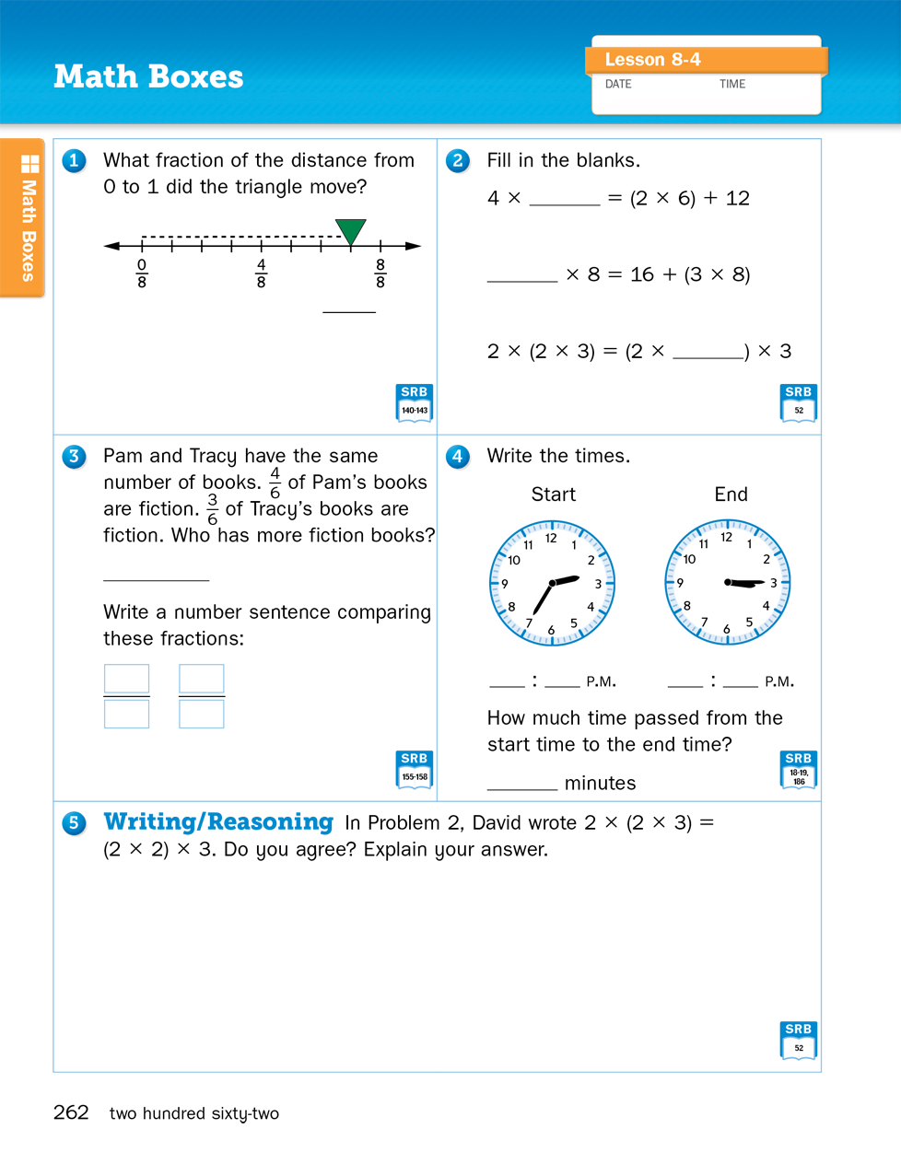
Math
Boxes
Page 262

Slide 19
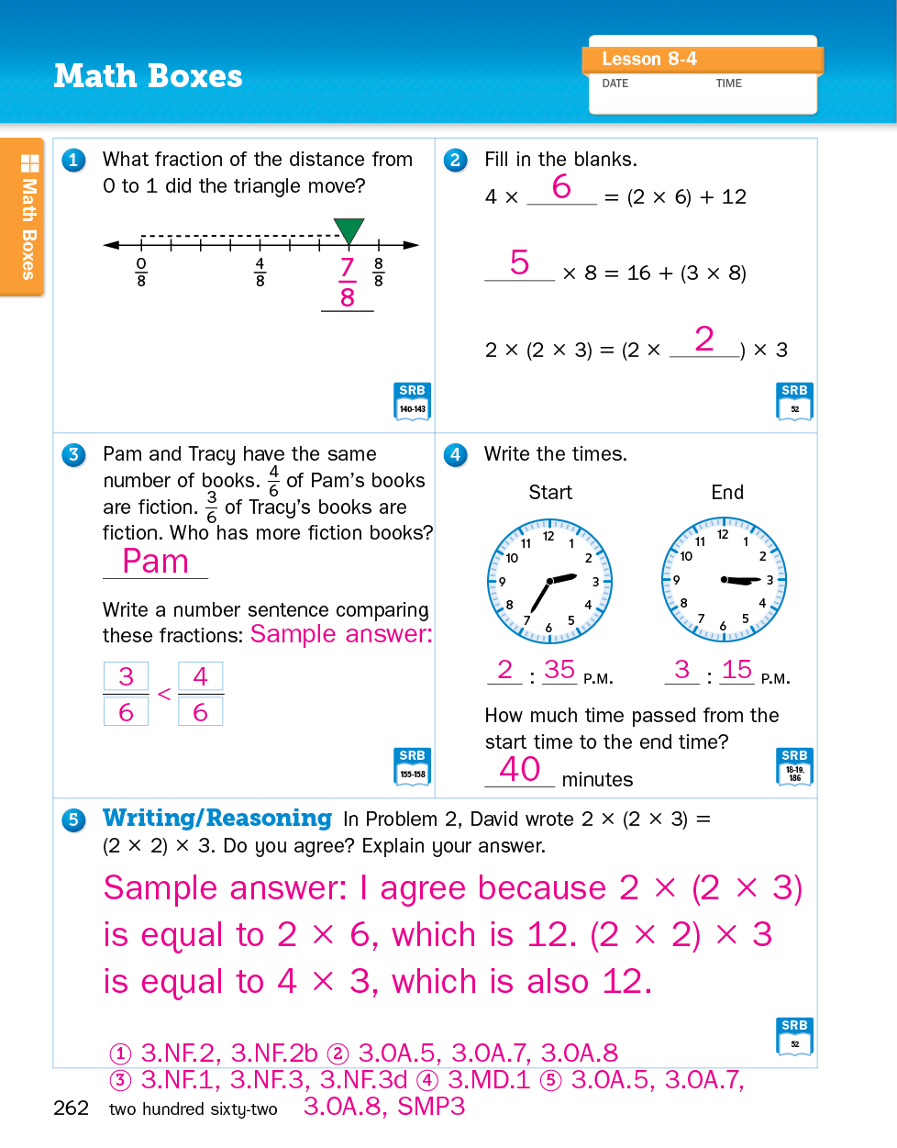
Math
Boxes
Page 262

Slide 20
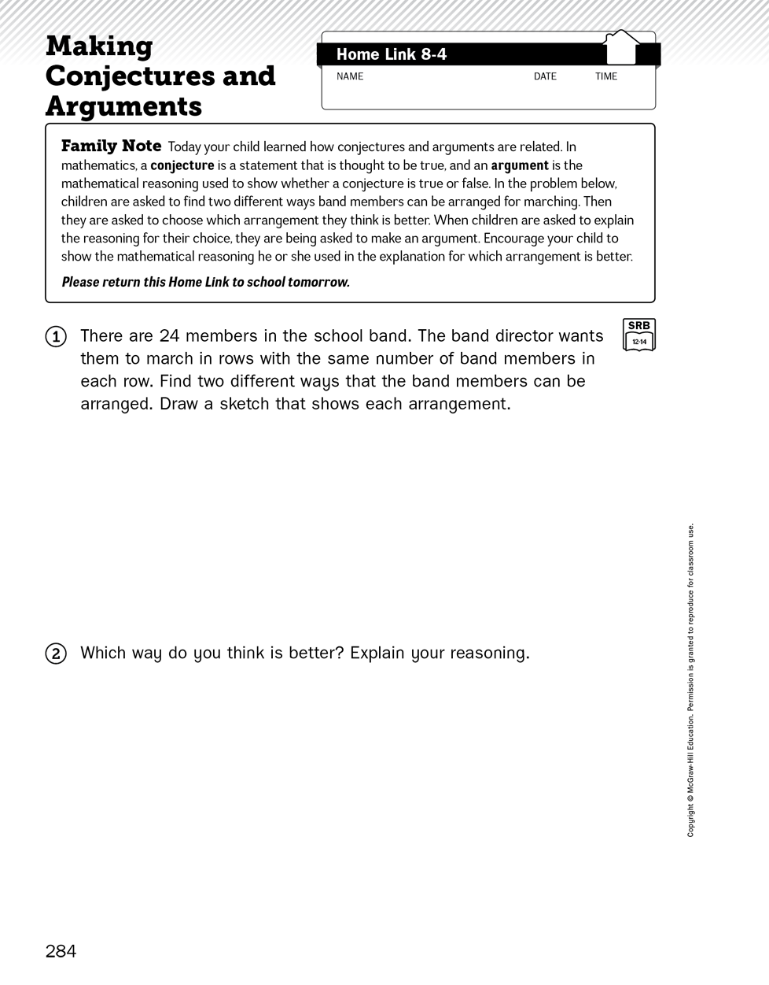
Home
Link

Slide 21
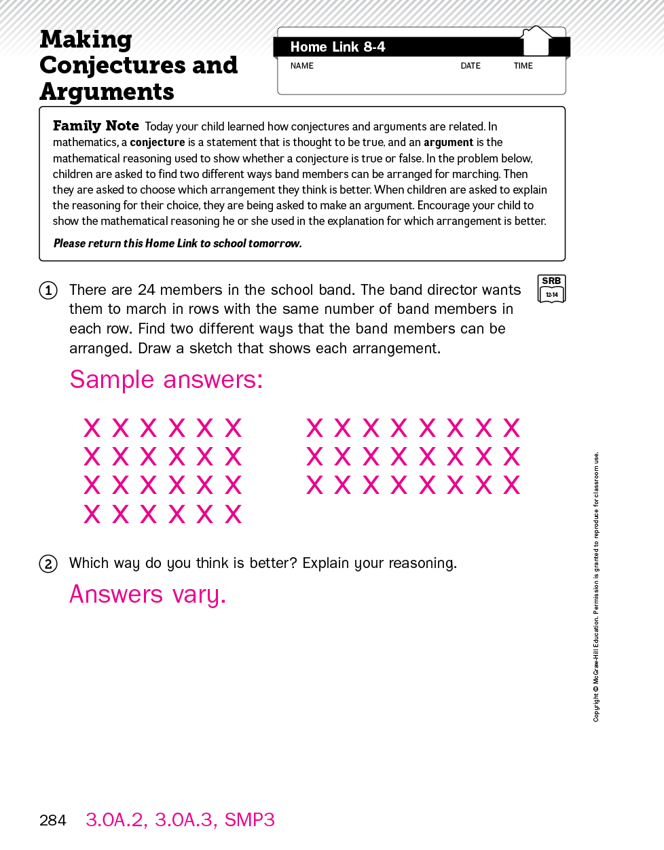
Home
Link

