Slide 1
Number Stories with Measures
7.3 Miss Hager

Slide 2
Mental Math and Fluency
Get out your calculators!
Skip count forward by 10s from 130 to 200
The next number in the count would be

Slide 3
Mental Math and Fluency
Get out your calculators!
Skip count backward by 10s from 1,000 to 950
The next number in the count would be

Slide 4
Mental Math and Fluency
Get out your calculators!
Skip count forward by 50s from 500 to 750
The next number in the count would be

Slide 5
Mental Math and Fluency
Get out your calculators!
Skip count backwards by 50s from 300 to 150
The next number in the count would be

Slide 6
Mental Math and Fluency
Get out your calculators!
Skip count forward by 25s from 250 to 450
The next number in the count would be

Slide 7
Mental Math and Fluency
Get out your calculators!
Skip count backwards by 25s from 750 to 500
The next number in the count would be

Slide 8
Bellringer:

Slide 9
Bellringer:

Slide 10
Math Message
Sanjay catches the bus at 2:05 P.M. It takes him 40 minutes to get to hockey practice. Practice starts at 2:30 P.M. How many minutes late will Sanjay be for practice?

Slide 11
Sanjay catches the bus at 2:05 P.M. It takes him 40 minutes to get to hockey practice. Practice starts at 2:30 P.M. How many minutes late will Sanjay be for practice?

Slide 12
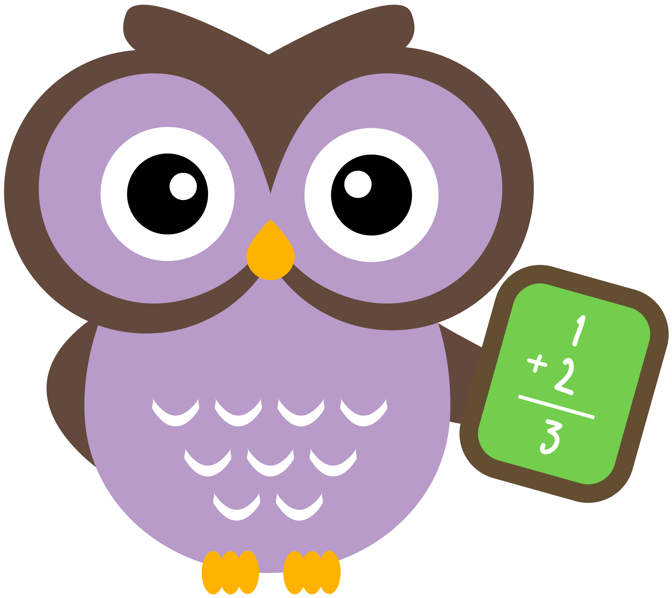
How do you solve number stories involving time, mass, volume, and length?

Slide 13
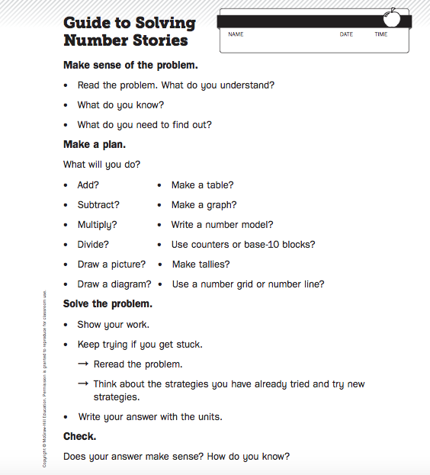

Slide 14
Journal Page 224

Slide 16
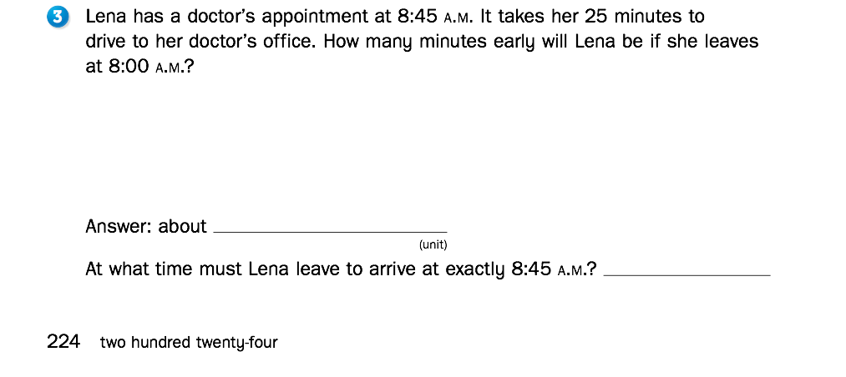

Slide 17
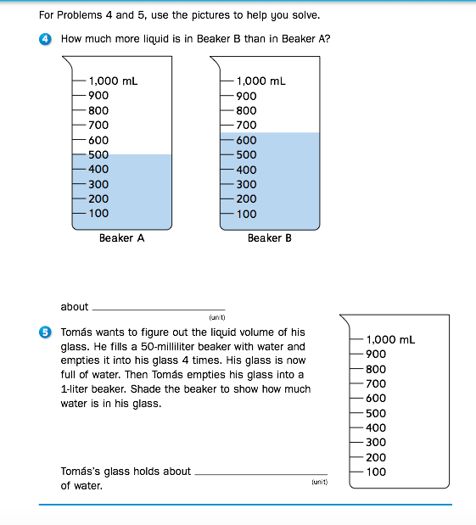
Journal
Page 225

Slide 18
How do you solve number stories involving time, mass, volume, and length?

Slide 19
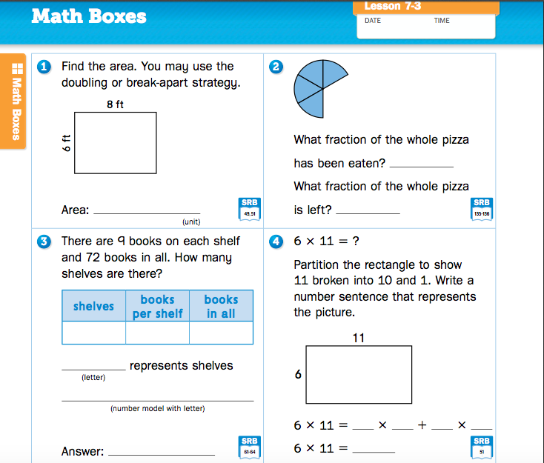
Journal
Page 226

Slide 20
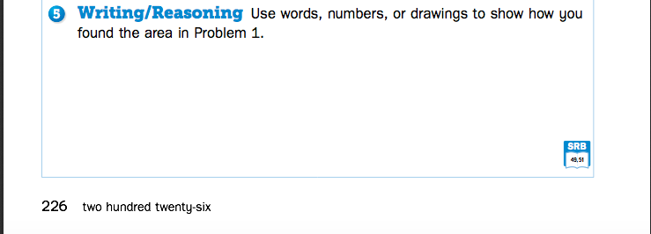
Journal
Page 226

Slide 21
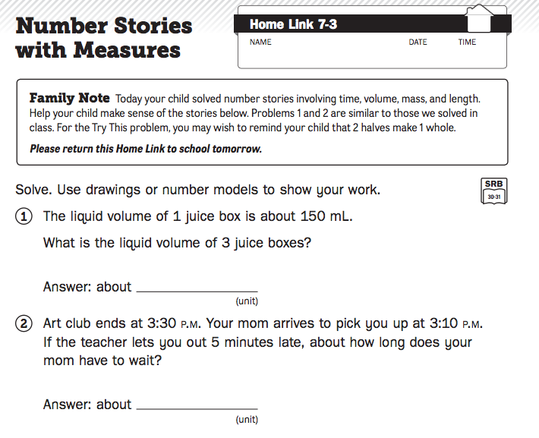
Homework

