Slide 1
Liquid Volume
7.1 Miss Hager

Slide 2
Key Learning:
Volume measurement is revisited with a focus on comparing, estimating, and then measuring liquid volumes. An understanding of fractions as numbers is continuing to be developed. A new area fraction model is explored, and fractions are represented as distances on number lines.

Slide 3
Unit Essential Question:
How do you solve problems involving fractions?

Slide 4
Mental Math and Fluency Think FAST and use ESTIMATION to help you!
One of these has a sum of about 250. Write that problem not the sum.
123 + 130
54 + 310
113 + 48

Slide 5
Mental Math and Fluency Think FAST and use ESTIMATION to help you!
One of these has a sum of about 500. Write that problem not the sum.
253 + 109
297 + 210
28 + 402

Slide 6
Mental Math and Fluency Think FAST and use ESTIMATION to help you!
One of these has a sum of about 1,000. Write that problem not the sum.
964 + 325
689 + 546
748 + 233

Slide 7
Challenge Bellringer:

Slide 8
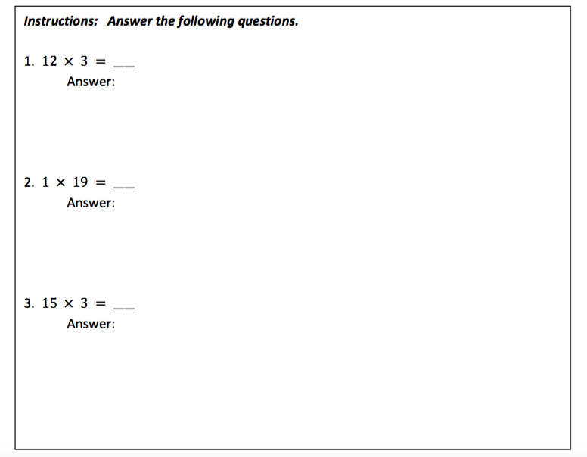
Bellringer:

Slide 9
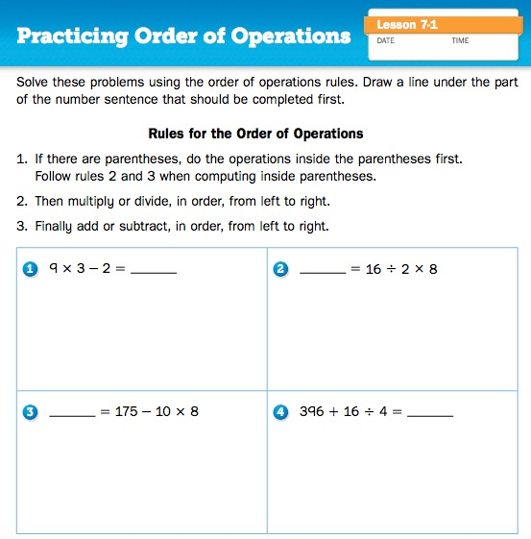
Journal Page 220

Slide 10
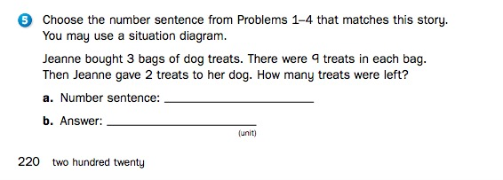
Journal Page 220

Slide 11
How do you measure and compare liquid volumes?

Slide 12
Math Message
Look at three containers. Which do you think has the greatest volume? How could you find out? Discuss with your partner.

Slide 13
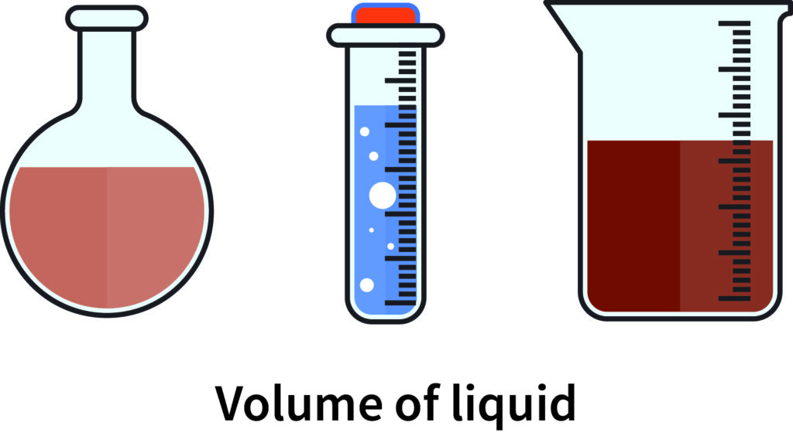
Math Message Follow-up/ Vocabulary
Liquid Volume- How much a container can hold.

Slide 14
Which strategies can we use to figure out which container has the greatest volume?
Math Message Follow-up/ Vocabulary

Slide 15
What tools can you use to measure liquid volume in standard units?
Math Message Follow-up/ Vocabulary
Liter beaker
Measuring cup

Slide 16
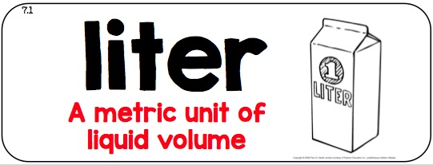
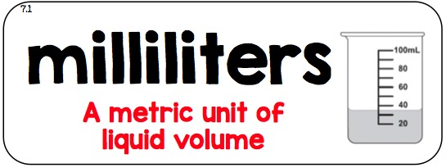
What are some standard units you can use to measure liquid volume?

Slide 17
How do you measure and compare liquid volumes?

Slide 18
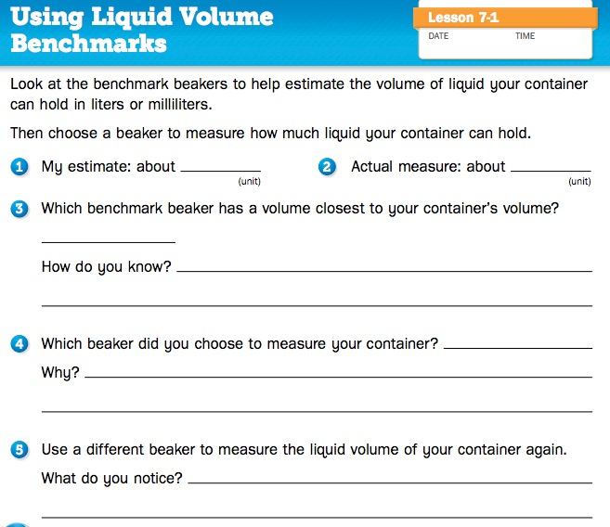
Journal Page 218

Slide 19
Journal Page 218

Slide 20
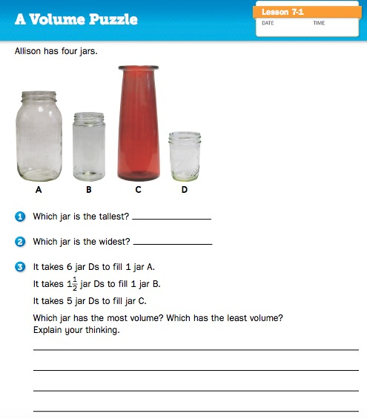
Journal Page 219

Slide 21
What did you learn about liquid volume?
Read about standard units of liquid volume on SRB page 182 with a partner.
Summarize:

Slide 22
How do you measure and compare liquid volumes?

Slide 23
Ticket Out the Door

Slide 24
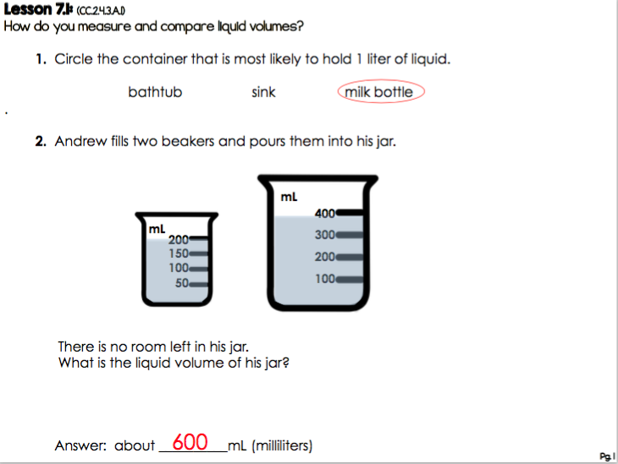
Ticket Out the Door

Slide 25
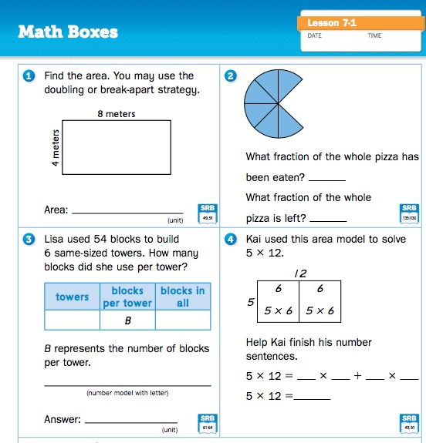
Math Boxes:
Journal Page 221

Slide 26
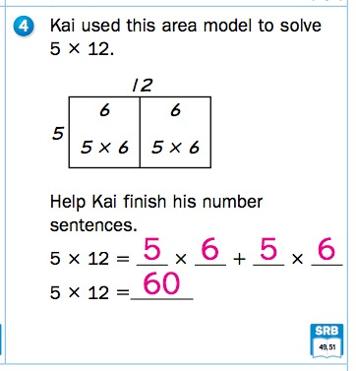
Math Boxes:
Journal Page 221

Slide 27
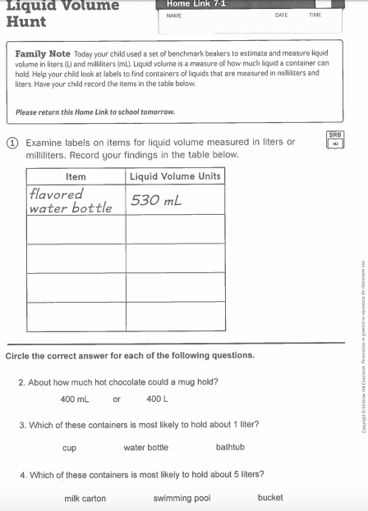
Homework

