Slide 1
8.7 Exploring Number Lines, Fractions, and Area
Miss Hager

Slide 2
How many 500mL beakers of water would it take to fill 1L beaker?
Bellringer

Slide 3
How many 250mL beakers of water would it take to fill 1L beaker?
Bellringer

Slide 4
How many 100mL beakers of water would it take to fill 1L beaker?
Bellringer

Slide 5
How many 1mL drops would it take to fill the 100 mL beaker?
Bellringer

Slide 6
How many 1mL drops would it take to fill the 250 mL beaker?
Bellringer

Slide 7
Plot: Mark the location of fractions on a number line.
Vocabulary

Slide 8
Essential Question: Exploration A: How do you plot fractions on a number line? Exploration B: How do you construct a rectangle when given its area? Exploration C: How do you identify equivalent fractions using fraction circles?

Slide 9
Imagine a number line from 0 to 1 with $\frac{1}{6}$ ,$\frac{2}{6}$, $\frac{3}{6}$, $\frac{4}{6}$. Which fraction is closest to 0? Which is the closest to 1?
Math Message

Slide 10
Exploration A:

Slide 11
Exploration B:

Slide 12
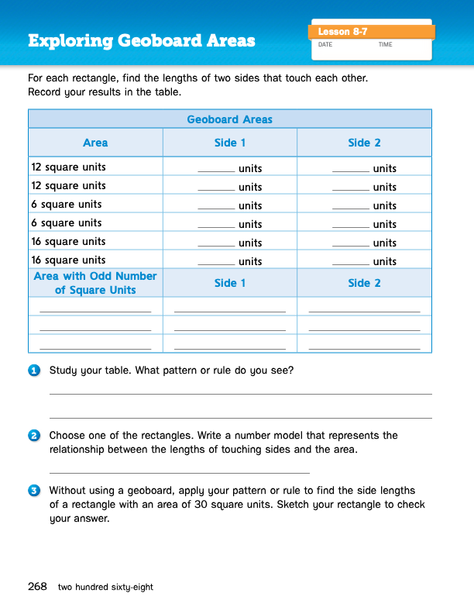
Journal Page 268

Slide 13
Exploration C:

Slide 14
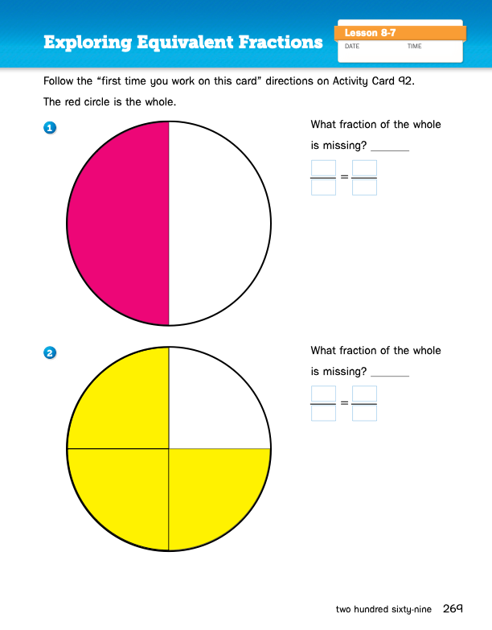
Journal Page 269

Slide 15
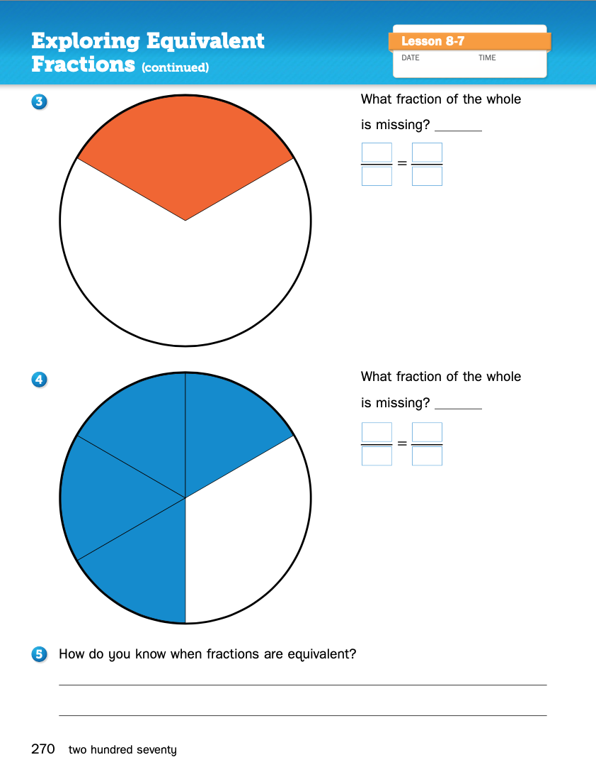
Journal Page 270

Slide 16
Share the pattern or rule you wrote for Problem 1 on page 268.

Slide 17
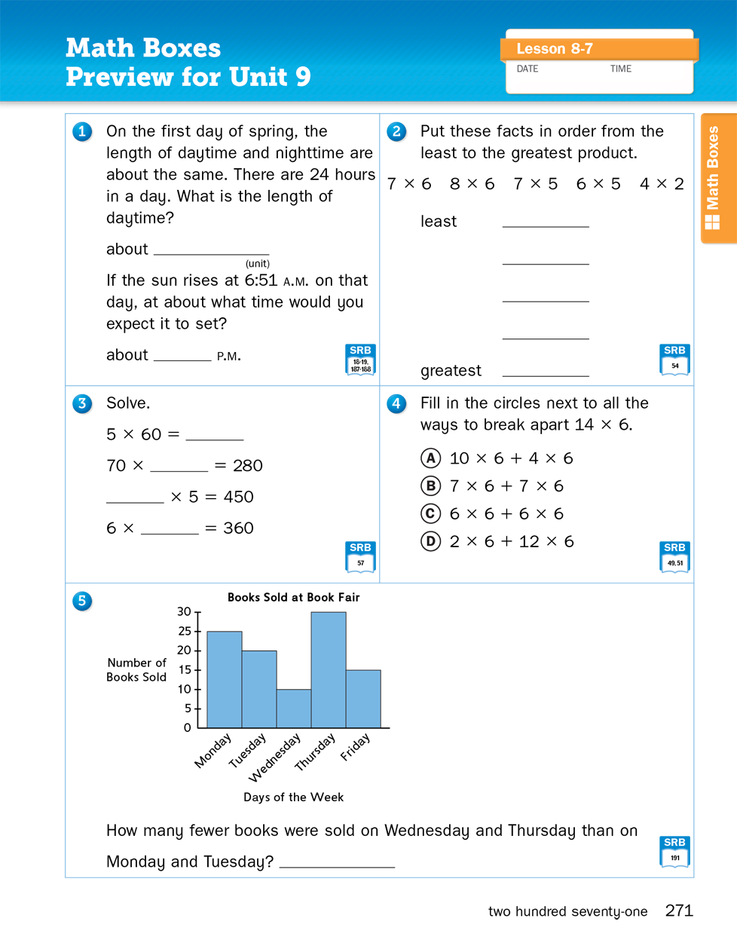
Math Boxes

